Slide 1
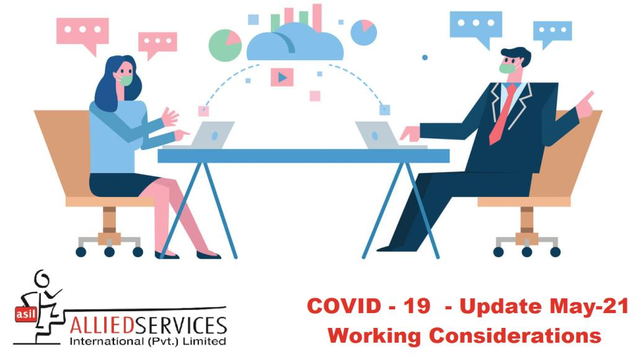

Slide 2
Work Considerations and Guidelines
The impacts of our COVID-19 response have changed many aspects of our current workplace. As we return to work, we will be prioritizing health and safety practices on all fronts:
Socially distanced workplace layout and spacing
Socially distanced worksite behaviors
Education on common COVID-19 symptoms, and planned responses to COVID-19-related symptoms and positive tests
Updates to cleaning procedures
Proper use of masks or face coverings
By following updated best practices, you can help prevent the spread of COVID-19 and future diseases, and protect the health and safety of fellow employees and guests.

Slide 3
Understanding COVID-19
How the Virus Spreads
According to the NIMS, Coronavirus (SARS-CoV-2) is the virus that causes COVID-19.
The virus is primarily spread person-to-person.
Examples of spread risk include:
Between people who are in close contact (6 feet or closer)
Through droplets—passed into the air (sneezing, coughing, singing, etc.)

Slide 4
Understanding COVID-19
Signs & Symptoms
As you return to the workplace, make sure you are aware of common symptoms of COVID-19. According to the NIMS, COVID-19 can have a wide range of symptoms that may appear 2-14 days after an individual contracts the virus.
Common Symptoms: Other Symptoms:
Fever 90%
Fatigue 70%
Dry Cough 59%
Body Aches 35%
Shortness of breath 31%
Mucus or phlegm
Sore throat
Headache
Chills, sometimes shaking
New loss of taste or smell
Emergency Symptoms:
Trouble breathing
Constant pain or pressure in the chest
Sudden confusion
Bluish lips or face

Slide 5
Understanding COVID-19
At-risk Individuals
According to the Ministry of National Health Services, there are high-risk categories of our population that contract COVID-19.
Within our workplace, these high-risk categories include:
People ages 65 and older
Immunocompromised individuals
People with medical conditions, including;
Chronic lung disease
Moderate or severe asthma
Serious heart conditions
Severe obesity
Diabetes
Chronic kidney disease undergoing dialysis
Liver disease
Please be mindful of those in a high-risk category, including yourself and those around you.

Slide 6
Workplace Engagement Update
Updated Practices
When returning to work, it is important that we all participate in safe practices.
Our updated employee expectations will include:
Discouraged shaking hands and hug greetings. While shaking hands and hugging in Pakistan is instinctual, these greetings can spread germs, diseases, and illnesses at an expedited rate.
Adjusted meeting practices. Until further notice, meetings should be conducted virtually when possible. In the event of an in person meeting, limit participants, spread out as much as possible, and avoid shared multi-touch devices.

Slide 7
Protecting Yourself and Others
Avoid Touching Your Face, and Cover Your Coughs and Sneezes
According to the NIMS, COVID-19 is primarily spread from person to person.
To help prevent the spread, please follow these guidelines:
Avoid touching your face, including your nose, mouth and eyes. Any time you touch your face, immediately wash your hands afterward.
Make sure you cover your coughs or sneezes with your elbow or a tissue. Immediately wash your hands and throw out any tissues afterward.

Slide 8
Protecting Yourself and Others, Cont.
Hand-washing and Social Distancing
As COVID-19 primarily transfers from person to person, one of the best ways to prevent the spread is washing your hands.
Hand-washing routines should include the following:
Washing your hands frequently with soap and water, for at least 20 seconds.
If soap and water are unavailable in your work area, using hand sanitizer with at least 70% alcohol.
Social distancing for yourself and others should include:
Making every effort to maintain a distance of 6 feet from each other whenever and wherever possible.

Slide 9
Protecting Yourself and Others
Updating Cleaning Practices
We have updated our cleaning practices to help ensure that COVID-19 isn’t lingering in the air or on surfaces. Our updated cleaning practices include:
Increasing the frequency of cleaning routines, and ensuring routines include multi-touch surfaces and devices.
Ensuring that cleaning routines include use of disinfectants.
Increasing access of cleaning supplies to employees, such as hand sanitizer, sanitizer wipes, and more.
Each employee can contribute to keeping the workplace clean. To demonstrate our efforts to help you out, you’ll find hand sanitizer and disinfectant supplies readily available.

Slide 10
Protecting Yourself and Others, Cont.
Cleaning your Area
We are implementing appropriate cleaning measures in response to COVID-19; however, each employee can play a part by keeping their work area clean.
As part of our updated cleaning practices, we encourage you to:
Ensure your work area is cleaned regularly.
Disinfect all electronic devices (to manufacturers’ recommendations), or with alcohol-based wipes or sprays containing at least 70% alcohol.

Slide 11
Face Coverings and Masks
Overview
According to the NIMS, masks and face coverings can help prevent the spread of COVID-19. The NIMS currently recommends wearing face coverings in public, and in the workplace.
What is the difference between masks and face coverings?
A face covering refers to a cloth covering of the face and is not a medical-grade mask. Masks refer to filtering respirators, such as an N95, KN95, medical-grade or surgical mask. Masks are considered critical supplies, which are reserved for health care workers and other medical first responders.

Slide 12
Face Coverings and Masks, Cont.
Properly Using Masks in the Workplace
When wearing masks in the workplace, follow NIMS guidance for best practices:
Before entering the workplace, ensure your mask is snug and secure, and you are able to breathe comfortably and without restriction.
Remember—wearing a mask does not replace COVID-19 best practices, such as washing hands often, maintaining social distancing of 6 feet or more, and avoiding touching of the face.
When it is time to take off a mask, wash your hands first. Avoid touching hands to your face, nose and mouth. As soon as the mask has been removed, make sure to wash your hands immediately.
Cloth face coverings should be washed in a washing machine between uses.

Slide 13
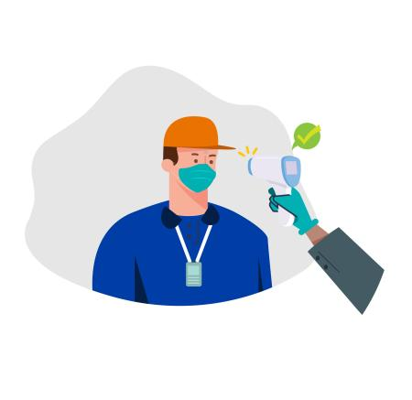
Employee Screening
Screening Employees’ Temperatures in the Workplace
Prior to arrival at the workplace we ask that you self screen and monitor symptoms. Should workplace screening be conducted, employees can be assured:
All screenings will be conducted on a nondiscriminatory basis.
Test results will be treated as confidential medical records, separate from the employee’s personnel file.
Testing stations will maintain proper disinfecting and social distancing procedures.

Slide 14
Symptomatic Employees
Employees who have COVID-19-related symptoms should report symptoms immediately to their manager.
Report symptoms using phone or email as soon as possible.
Employee’s identity will remain confidential. We will help employees coordinate taking leave or paid time off in the event they require isolation.
Employee should be professionally evaluated for COVID-19. We will communicate steps for the employee to take a COVID-19 test.
We will take steps to isolate employees who are suspected of having COVID-19. If a professional concludes the employee is likely to have contracted COVID-19, the employee will then self-quarantine and will implement our company’s COVID-19 test response plan.

Slide 15
Positive Coronavirus Test Action Plan
Should an employee test positive for COVID-19, we have a specific plan in place to respond.
Next steps would include:
Responding directly to the employee
Isolating the employee
Notifying employees, customers, vendors, and guests
Disinfecting appropriate work areas
Determining further staff or department isolation or closure measures as required

Slide 16
Positive Coronavirus Test Action Plan
Responding Directly to the Employee
After a positive test, we will address the employee directly regarding next steps and offer assistance.
Be assured, any employee testing positive for COVID-19 will have their identity remain confidential, and we will be sure to help them coordinate taking leave or paid time off until they’ve been cleared by their physician to return to work.
We will ask the employee some questions, including with whom the employee has been in contact within the last two weeks.
Obtaining this information will be essential as we notify employees and others who may have been directly exposed to COVID-19.

Slide 17
Positive Coronavirus Test Action Plan
Isolating the Employee (as recommended by the NIMS)
In the event of a positive COVID-19 test and the employee(s) shows symptoms, the employee(s) will be advised to go into isolation, and will continue until the following three conditions are met:
At least 10 days since symptoms first appeared and
At least 24 hours with no fever without fever-reducing medication and
Symptoms have improved
Depending on your healthcare provider’s advice and availability of testing, you might get tested to see if you still have COVID-19. If tested, you can be around others when you have no fever, respiratory symptoms have improved, and you receive two negative test results in a row, at least 24 hours apart.
For employees who test positive for COVID-19, but have no symptoms, isolation will continue until the following:
10 days have passed since test
Depending on a healthcare provider’s advice and availability of testing, you might get tested to see if you still have COVID-19. If tested, you can be around others after you receive two negative test results in a row, at least 24 hours apart.
If you develop symptoms after testing positive, follow the positive test with symptoms guidance above.

Slide 18
Positive Coronavirus Test Action Plan
Notifying Employees, Customers, Vendors and Guests
After we recommend the employee self-quarantine for the next 10 days and monitor themselves for symptoms of COVID-19, we will move on to planned next steps. These steps will include:
Directly notify any co-workers or customers with whom the ill employee had been in contact.
Make determinations on who should be self-isolating.
Notify all employees by email that an employee has tested positive for COVID-19. The employee’s identity will remain confidential.
At that time, we will advise about any temporary closings for disinfecting, and any remote work expectations.

Slide 19
Positive Coronavirus Test Action Plan
Disinfecting the Workplace
After a positive test, we will disinfect the workplace.
Facilities may partially or fully close down for 72 hours to disinfect the workplace.
The workplace will be cleaned following guidance from the NIMS, using disinfectants approved by the Environmental Protection Agency (EPA) for use against SARS-CoV-2, the virus that causes COVID-19.
Employees may be eligible for remote work. Communications will come out from your manager on further steps to be taken.
If the employee has not been in the office for seven days or more, additional cleaning will not be required to supplement routine cleaning procedures.

